Slide 1

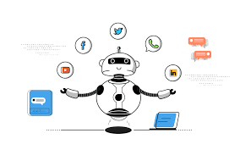
CHATBOT
By
JANGALA RAMU SAILOHITHA

Slide 2

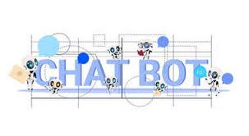
Contents
Introduction
Abstract
Existing System
Proposed System
System Requirements
Modules
Designs
Results
Chatbot being Social Relevant
Conclusion
Future Scope
References

Slide 3


Introduction
Chatbot is an automated software program that interacts with humans using natural language.
Chatbot are programs that work on Artificial Intelligence(AI) & Machine Learning platform.
This software program conducts conversation with users via textual methods
In this project, Chatbot is developed using python programming language in google collabs.

Slide 4

ABSTRACT
The application “CHATBOT USING PYTHON” is designed by python using JSON Database structure.
A chatbot suits the user needs and requirements.
Chatbots are usually a stateful services, remembering previous commands in order to provide functionality.
It gives answers to the user in a text-based commands. The questions could be regarding college details.

Slide 5
Existing system
User need to personally visit the college and ask the college help desk , if the student have any queries about the college.
It takes lot of time and money if the college is miles away from the student native place.
DISADVANTAGE:
The chat bot system is not known to people who do not have more knowledge about the technology
Even if there exist a chatbot system , it is not much accurate in providing the answer or solution
Also this process may lead to communication gap between student and college

Slide 6
PROPOSED SYSTEM
This application provides answer to the query of the student.
Students have to query through the bot which is used for chatting.
The system uses Built in tensorflow , tflearn libraries and NLP , Neural network concepts.
The answers are appropriate what the user queries.

Slide 7


ADVANTAGES OF PROPOSED SYSTEM
Chart bot can run on local computers and phones , smart devices.
Eliminates the requirement of any manpower during online interaction.
Chat bot is typically perceived as engaging software entity.
It is an extremely helpful and useful system for disabled people.

Slide 8
SYSTEM REQUIREMENTS
Software requirements
Operating system : Windows 10
Coding language : Python 3.8
Tool Used : Google Colab
Front end : HTML 5.2, CSS3
Data Base : MySQL 8.0.21

Slide 9
Hardware requirements
Processor : intel core5
Hard disk : 250GB
Monitor : 15”LED
RAM : 4 GB
Input devices : Keyboard , Mouse

Slide 10
MODULES
User
Chat Bot
Information

Slide 11
User Module
Speech to Text: User will ask the computer to run command by giving input as speech.
Command Execution: Based on command receive from the user, system will execute the command (if available).
Text to Speech: Once a command is received, application speaks the command.

Slide 12
Chatbot Module
To make a conversation between both human and machine.
The machine has been embedded knowledge to identify the sentences and making a decision itself.
User can chat with the bot it implies as if enquiring to the college person about college related activities.

Slide 13
Information Module
This system can answer the questions asked by the user.
The question relevant to college the system search and gives that particular college information.

Slide 14
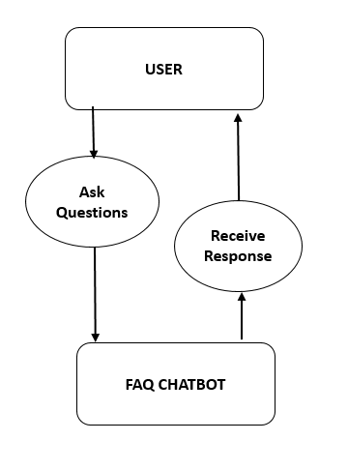
UML DIAGRAMS
USECASE DIAGRAM

Slide 15
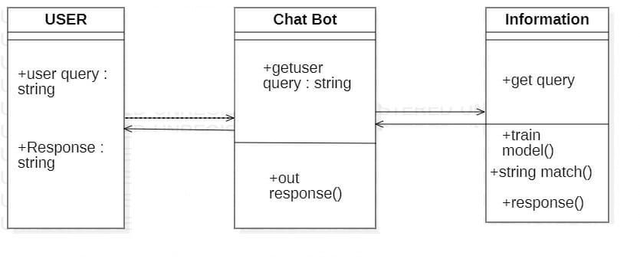
CLASS DIAGRAM

Slide 16
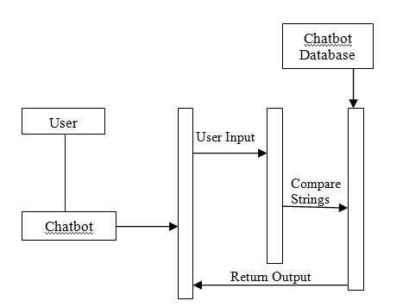
SEQUENCE DIAGRAM

Slide 17
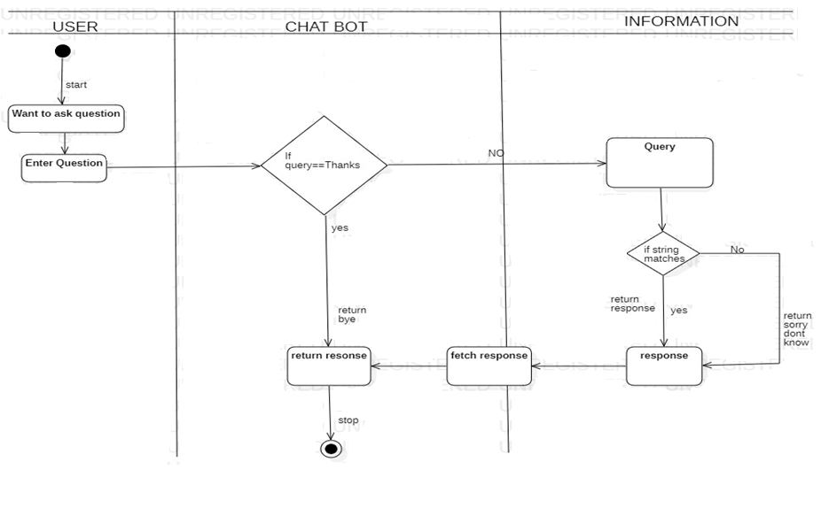
ACTIVITY DIAGRAM

Slide 18
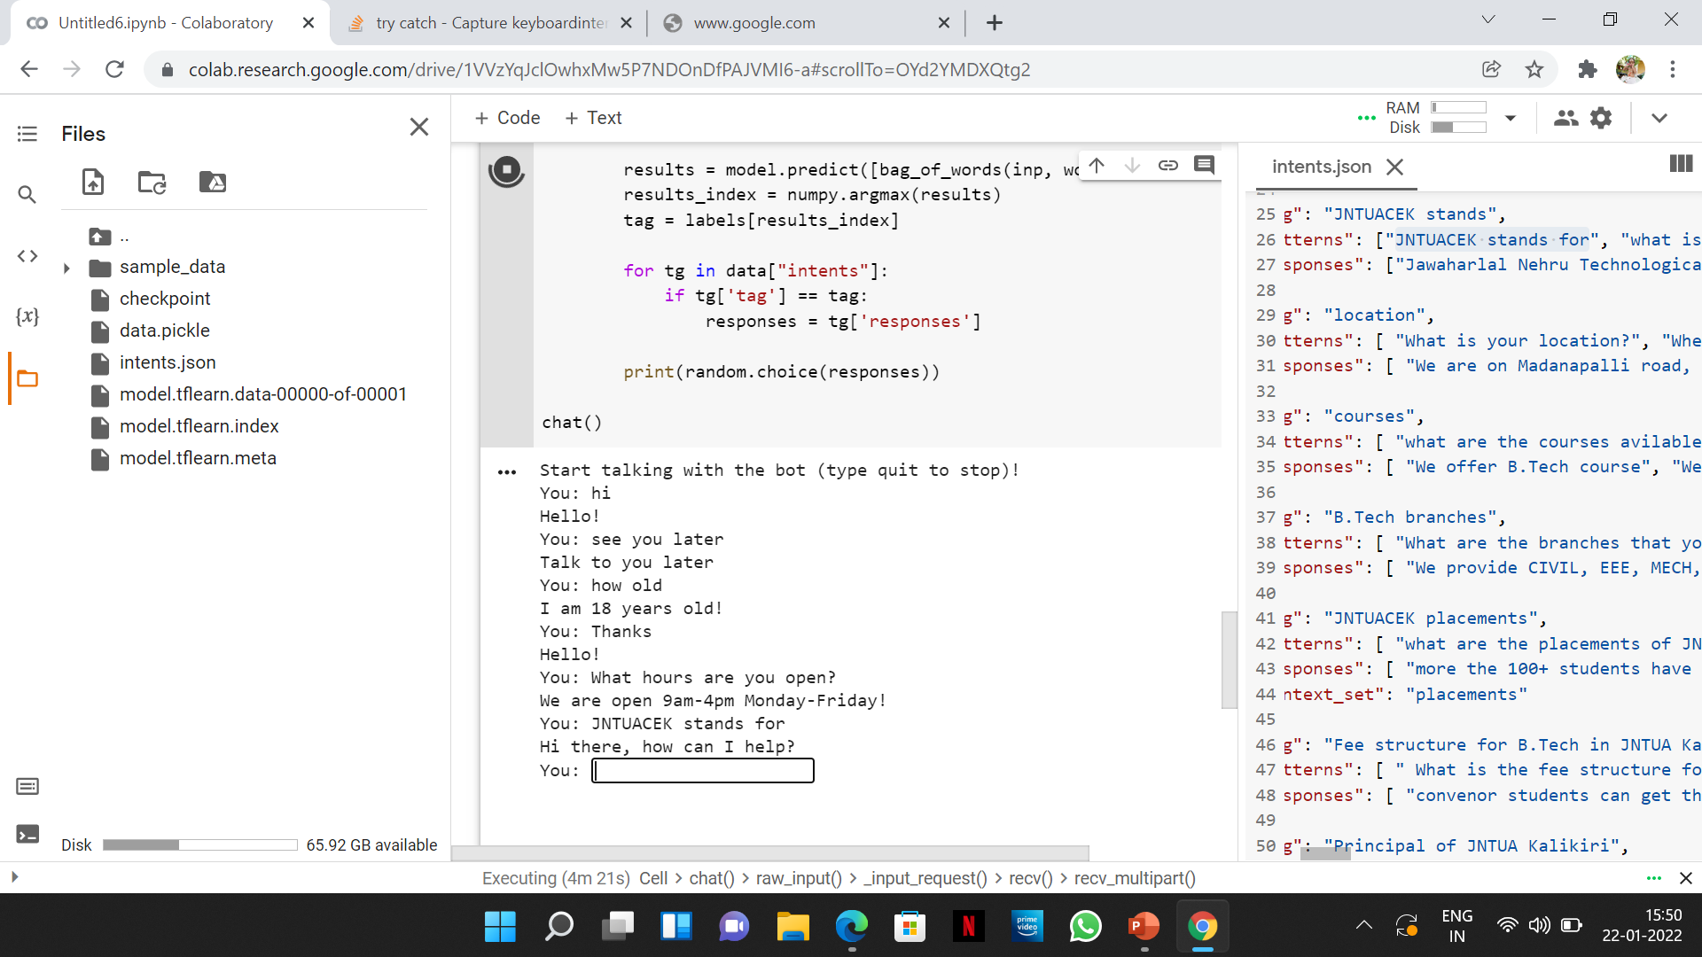
Result

Slide 19
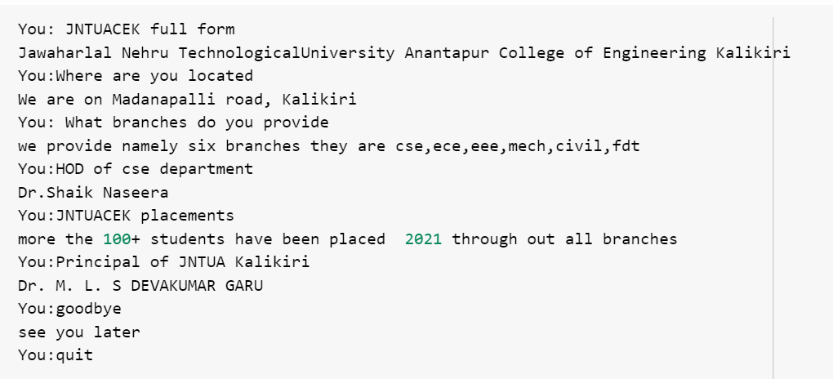

Slide 20

How chatbot aid the Contemporary Society
Chatbots are available immediately @24/7
It increases sales as well as frame
Provides wide range of applications in different industry and services
Helps to search the information faster and better than humans
It provides immediate feedback

Slide 21
CONCLUSION
This chatbot can answer to the queries in the textual user input.
JSON file (which contains questions and its respective answers) has been created and loaded into the machine .
Chatbot can answer to the queries asked by the user.
In this project, chatbot contains the details about the college.

Slide 22
Future scope
It is getting more efficient day by day and the next scope is multilinguistic responses
Voice-bots are also set to enhance the services
Human alike
Adoption of AI to make accurate predication for query

Slide 23
References
[1] Bayan Abu Shawar and Eric Atwell, 2007 “Chatbots: Are they Really Useful?”
[2] Bringing chatbots into education: Towards natural language negotiation of open learner models. Know.- Based Syst. 20, 2 (Mar. 2007), 177-185.
[3] http://en.wikipedia.org/wiki/Chatterbot
[4] ALICE. 2002. A.L.I.C.E AI Foundation, http://www.alicebot.org/
[5] Kumar, M Naveen, PC Linga Chandar, A Venkatesh Prasad, and K Sumangali (2016). “Android based educational Chatbot for visually impaired people”. In: International Conference on Computational Intelligence and Computing Research (ICCIC), 2016 IEEE. IEEE, pp. 1–4.
[6] Ranoliya , Bhavika R, Nidhi Raghuwanshi , and Sanjay Singh (2017). “Chatbot for University Related FAQs”. In: 2017 International Conference on Advances in Computing, Communications and Informatics (ICACCI). Udupi, pp. 1525–1530.

Slide 24
THANK YOU

